Slide 1
Data analysis of E-retail factors for customer activation and retention (Indian e-retailers)
Submitted by:
Vijaya Mukati

Slide 2

Introduction
The rapid growth of e-commerce, which is a result of the remarkable advancement of the Internet and technology, presents a new paradigm for conducting business worldwide.
Online shopping has become one of the main channels of shopping due to its advantages like:
1) Availability of variety of services and products according to preferences.
2) Convenience
3) Round the clock availability,
4) Flexible pricings and discounts
5) Free door step delivery
Therefore more and more people are keen to buy from e-retail websites and hence the decision making by e-retailers becomes very much important in terms of customer activation and retention.

Slide 3
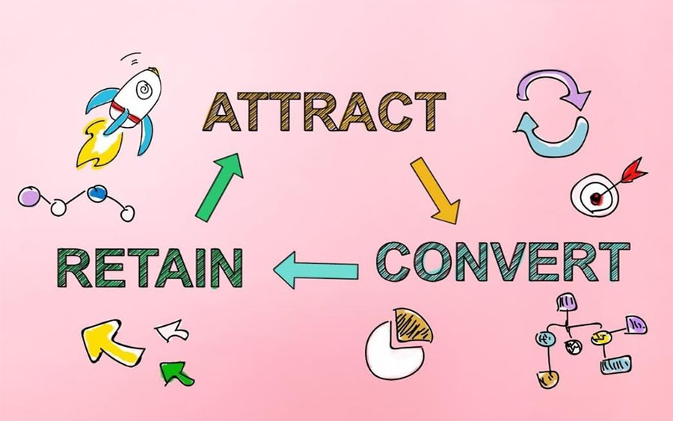
Brief Introduction
Customer acquisition is the process of finding and persuading prospective customers to buy from your business.
Customer retention is the collection of activities a business uses to increase the number of repeat customers and to increase the profitability of each existing customer.

Slide 4
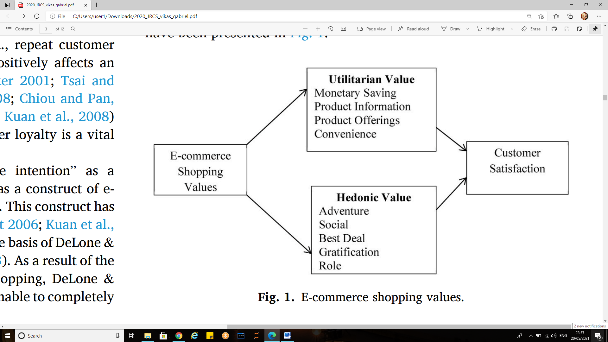
Shopping values for e-commerce
A website’s positive affect is related to both utilitarian and hedonic shopping value, impacting share of purchase.

Slide 5
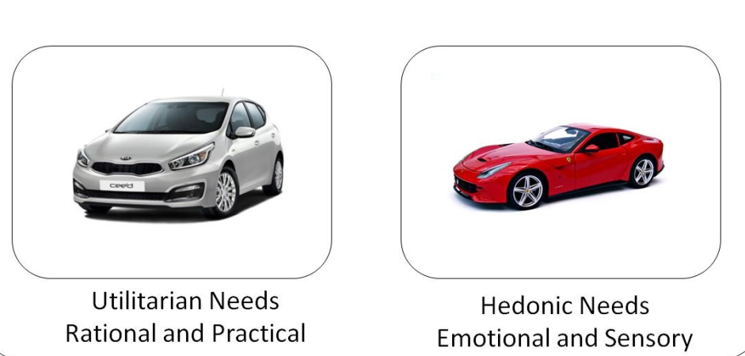
Hedonic and utilitarian values
Hedonistic values represent the excitement, and pleasurable experiences derived from shopping online
Example: whether the customer feels adventurous after shopping, social status etc. It is anticipated that the utilitarian and hedonic aspects are normally positively correlated
Utilitarian value is associated with effective, task-specific and economic facets of the products or services
Example: providing relevant product information, monetary gains etc.

Slide 6
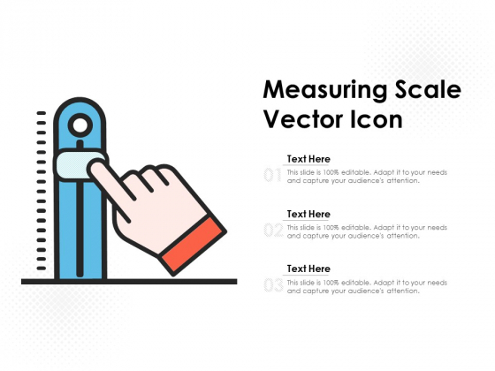
Hedonic and utilitarian values
The hedonic component can be measured by using scales like 'pleasing/annoying', 'happy/sad', 'beautiful/ugly‘.
The utilitarian component by using scales like 'valuable/worthless', 'foolish/wise', 'rational/irrational', profit/loss.

Slide 7
Understanding customer activation model
The model adopts three qualities
System Quality :System quality analyses the performance of the website; some of the metric includes; page load speed, ease of navigation between pages, website design, appearance, website availability, and website layout.
Information Quality: This can be defined as the customers’ perceptions towards the presentation and characteristics of information presented or displayed in an e-commerce website, web application or portal.
Service Quality:Service quality refers to how well the services delivered by an online retail store are able to match the expectations of the customer. Examples of such services may include; contact, responsiveness, and privacy .

Slide 8
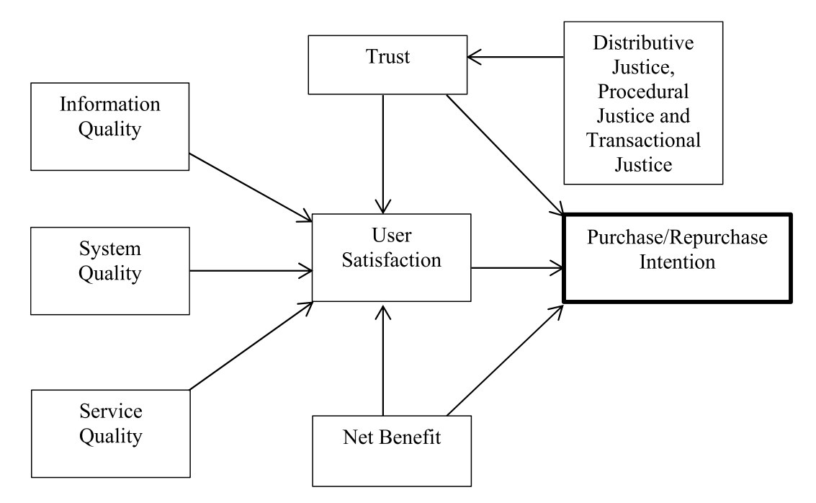
Proposed model for customer activation

Slide 9
Understanding customer activation model
User satisfaction defined as a personal feeling of contentment or pleasure, as a result of comparing the actual outcome of shopping online as against their expectation Satisfaction of online customers will positively impact their future intention (repeat purchase) directly or indirectly
Net benefits :This is used to describe the total benefits received while shopping online as against the costs (for example, effort, money and time). Some of the net benefits derived from online shopping include: monetary gain, product search and buying effectiveness, convenience, timely delivery, enjoyment, broad product range, and flexibility. Net benefit of shopping online includes both utilitarian value and hedonic values.

Slide 10
Understanding customer activation model
Trust :is the perception of a consumer that the merchant will transact with all ethically, capability, and efficient standard. trust produces a positive feelings toward the online retailers; this increases the chances of customer’s intention to buy a products, or use a service. Customer may never transact with the online retailer again if it does not improve on its trustworthiness.
Purchase/repurchase intention :can be defined as the likelihood that an online customer is going to buy a product and continue to purchase products from the same online retailer

Slide 11
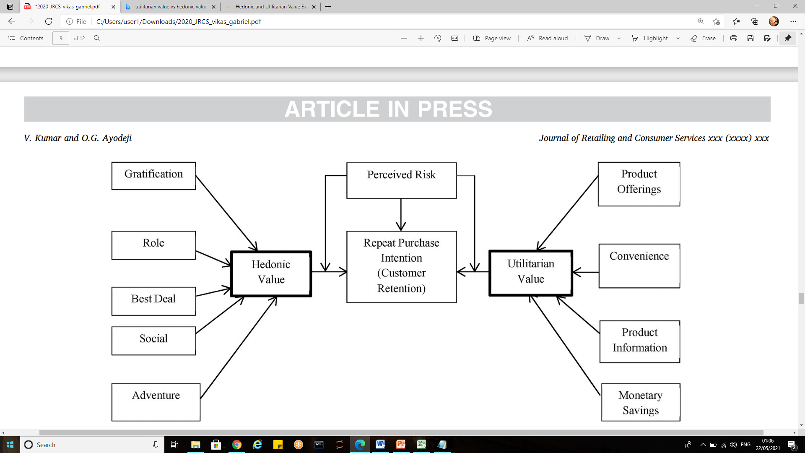
Proposed model for customer retention

Slide 12
Understanding customer retention model
Consumers expect a more social and interactive online experience to accumulate common intelligence and support decision-making. The hedonic aspects should be taken into account in designing the Website of a fashion retailer.
Dimension of hedonic values includes;
Role shopping refers to the online customers who shop to gain pleasure and self-approval when shopping under a different identity to perform a specific role at given time. It is the enjoyment that the online shoppers gets from shopping for the consumption of others (for example, father shopping for a child), shopping online for others, has been revealed as a source of joy for some customers.
Value shopping: According to Gupta and Kim, the research claimed that getting a bargain gives online consumers the feeling of having won a contest. One major benefit of shopping online is the ability to compare it observed that pleasure is also derived during the process of browsing for good deal, and listed it as also part of motives of customers shopping online.

Slide 13
Understanding customer retention model contd.
Social shopping: reflects the online retail customer propensity to strive for recognition and even friendliness through interpersonal relationships.
Adventure shopping: This type of shopping is engaged in by an online customer who is looking to escape bored therefore requires stimulation to get out of depression .A survey conducted online customers shows that, 95% of respondents agreed that shopping online serves an opportunity for departure from daily routine.
Gratification: gratification is a strong motive to shop online; it also improves the chances of buyer returning for a repeat purchase other products from the same e-retailer. It is the degree to which an e-store is entertaining and fun to the online customers, it is also the feeling of accomplishment after completing a task easily on the website. Other form of gratification includes receiving incentives for shopping on a particular website.

Slide 14
Understanding customer retention model contd.
Dimensions of utilitarian values:
Product offerings: This is described as the complete information on products or services offered for purchase to a customer by an online retailer, while displaying the height, depth, and breadth of the merchandise being offered Take for instance, a customer shopping on flipkart.com will be shown different categories of product (for example, Smartphones, computers, fashion etc.) to choose from, several option of any product choose is available for comparison.
Product information: The information quality of products displayed by an online retailer has to be detailed enough to enhance the customer decision in making a purchase or not. For instance, Amazon.com, gives detailed information on products being displayed to a consumer, this enables the consumer to learn about the technical specifications, attributes, size, and products features.

Slide 15
Understanding customer retention model contd.
Monetary savings: one of the major reasons of shopping online is to get value for money, in other words, spend less on products thereby saving more money, for instance, Amazon. in was offering 10% cash back on both Amazon pay and HDFC bank credit and debit cards and up to 40% discounts on selected products, in the Great Indian Sale in 2019.
Convenience: Online shopping is very effective because of it convenience, a lot of time and effort is saved when a consumer decides to shop online. Online shopping has the benefit of no restrictions on shopping hours. Online shopping allows customer the elasticity to order from any place, time, and day. This reduces the need to physically travel to a store, thereby saving time, energy, and money.

Slide 16
Understanding customer retention model contd. (Perceived risks)
Perceived risk In online shopping, risk is more pronounced than shopping in traditional physical store Risk may arise as a result of event which cannot be predicted perfectly, and may not be pleasant to the online customer . Perceived risk is an important factor in determining purchase intention, repurchase intention and even to become a loyal customer. Whenever buyers are faced with uncertainty and consequences that are not desirable as a result of a purchase made, they perceive risk . Not being able to completely track the e-retailers behavior as well as apprehensions concerning the security of shopping online will lead to a higher perceived online risk.

Slide 17
Analysis of the dataset

Slide 18
Dataset characteristics
The dataset has 269 rows and 71 columns
It has no null values
All the features except “pin-code” is object data-type
The dataset is studied by fragmenting the features according to hedonic and utilitarian values.
The jupyter notebook is attached at: https://github.com/ankitamhetre/blog-article/blob/main/customer%20retention%20data%20analysis.ipynb

Slide 19
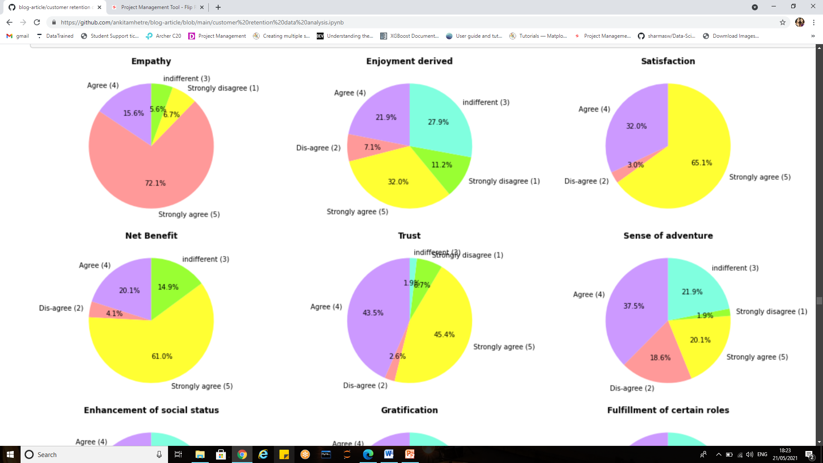
Hedonic values

Slide 20
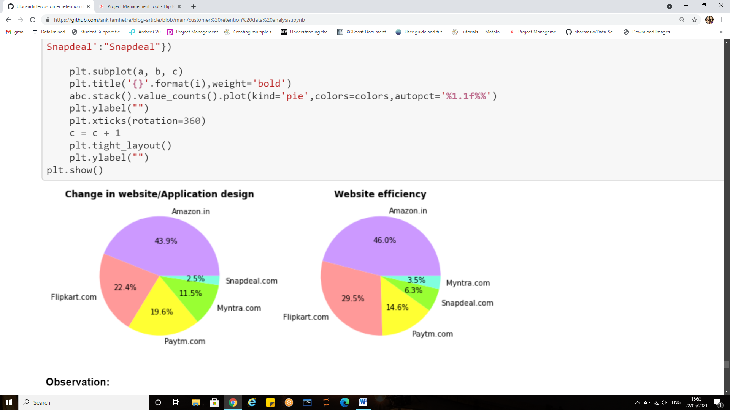
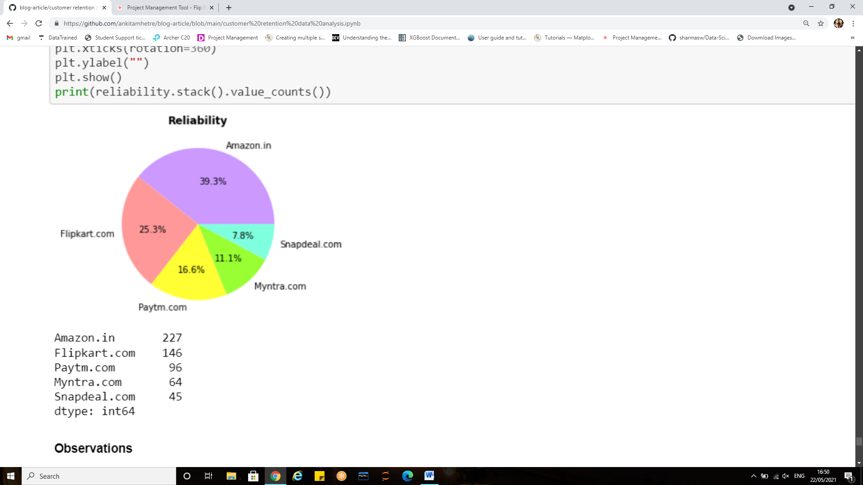
Hedonic values visualization

Slide 21
Observations
Observation for empathy (readiness to assist with queries) towards the customers:
About 72 % people feel that empathy (readiness to assist with queries) towards the customers is an important aspect for customer retention.
A very small portion of the population i.e. 6~7% have indifferent views for the same.
The majority could be seen agreeing to the fact.
Observation for reliability/website efficiency
39.35% people considered amazon as most reliable website for online purchasing which was the maximum.
Flipkart had the second most highest votes in terms of reliability
The least votes were given to snapdeal (7.8%)
Amazon made more number of changes in the website or design and still maintained maximum efficiency.
Snapdeal had the least changes in website/ application design its efficiency was 6.3%.
Myntra was given the least efficiency
Observation for visual appeal
Visual appeal is what meets the eye. It's the colours, shapes, pictures, fonts, white space, and overall visual balance of a design. Whether a website appeals to us affects how we perceive it, how we use it, and how we remember it
Amazon and flipkart were the ones who were considered visually appealing by the customers.
paytm and snapdeal were less attractive and seeks less attention

Slide 22
Observations on hedonic values
Observation for Is Enjoyment derived from shopping online:
Majority of share represents the strong agreement that means people do enjoy online shopping.
27.9% of the records say people have indifferent views on the same.
A very few people could be seen neglecting the enjoyment factor derived from online shopping i.e. 11.2 %( strongly disagree).
Observations for Do User derive satisfaction while shopping on a good quality website or application?
Thus majority of them are satisfied while shopping if the quality of website or application is good.
The survey states that there are no people who would like the quality of retail website to be in poor condition.

Slide 23
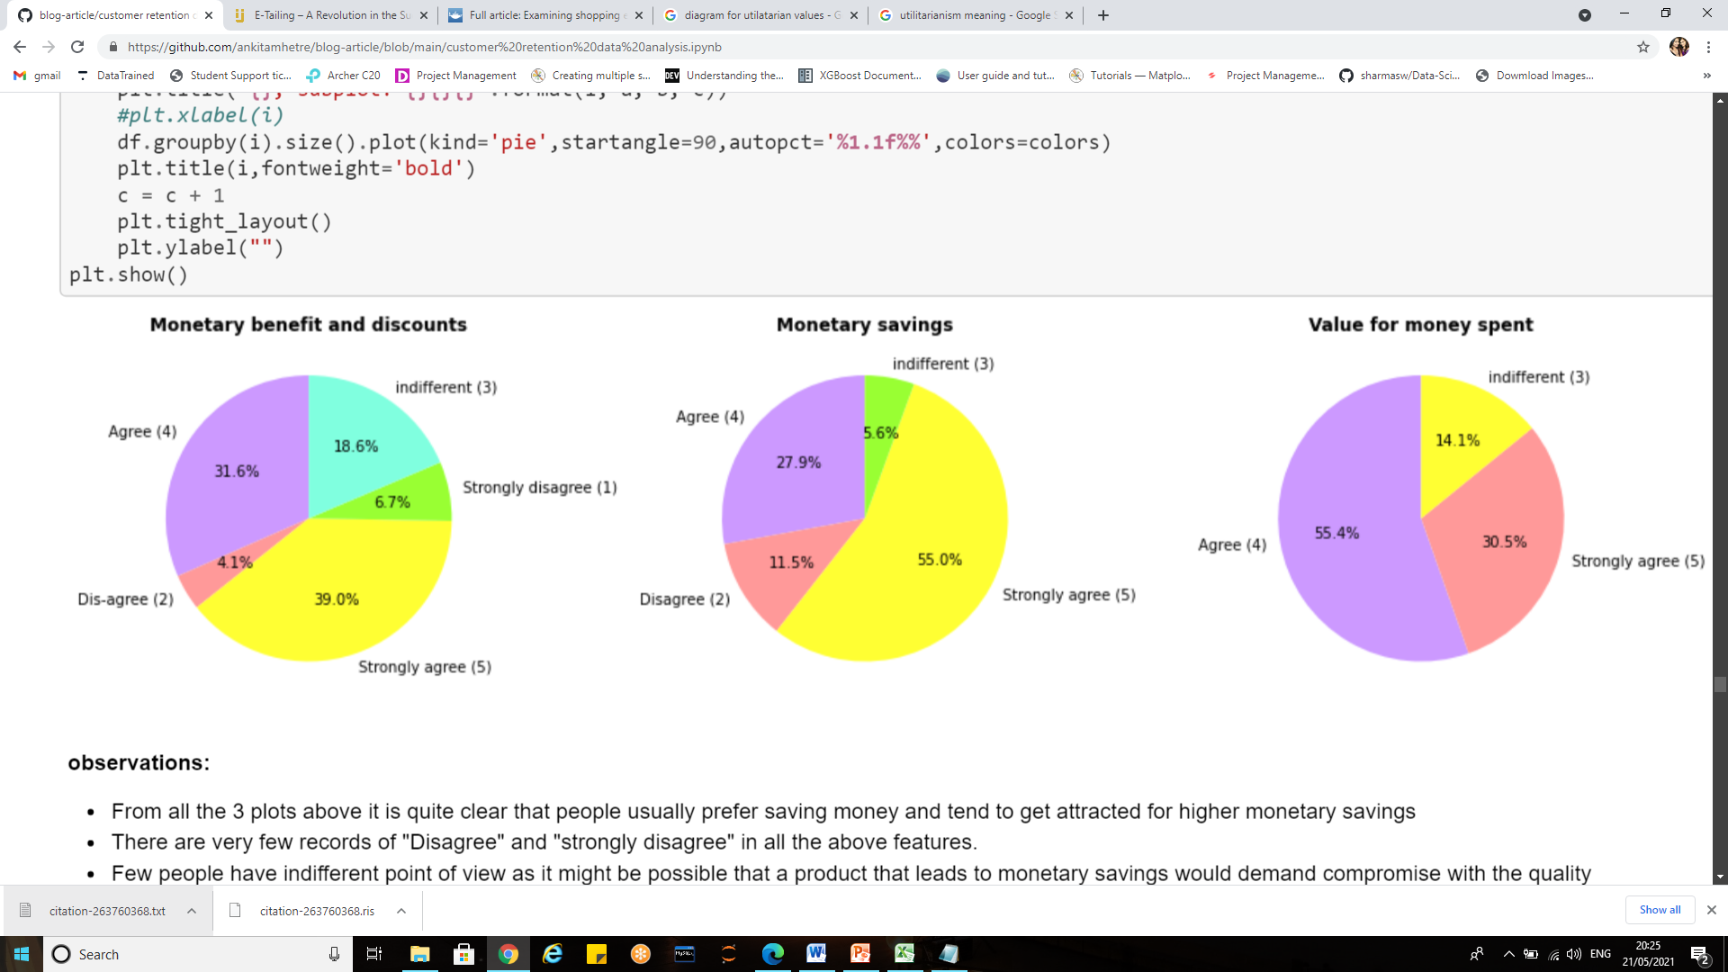
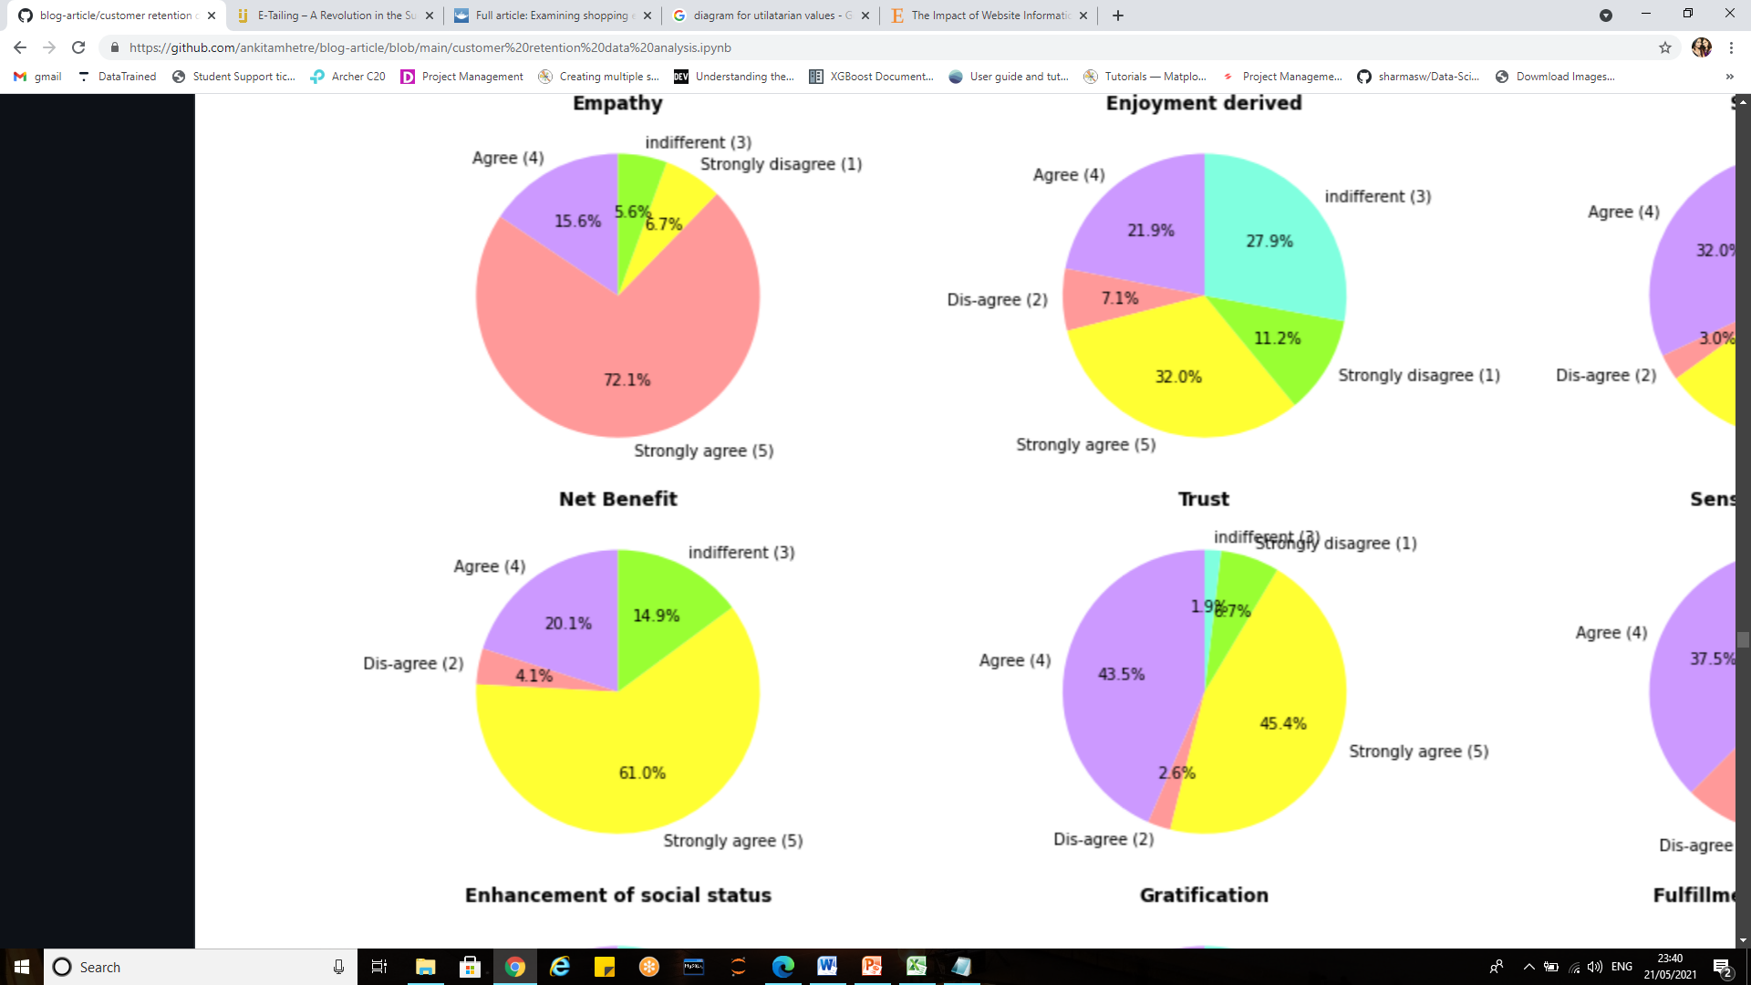
Utilitarian values visualizations
Monetary gains and benefits:

Slide 24
Observations
Observations from the visualizations:
From all the 3 plots above it is quite clear that people usually prefer saving money and tend to get attracted for higher monetary savings
There are very few records of "Disagree" and "strongly disagree" in all the above features.
Few people have indifferent point of view as it might be possible that a product that leads to monetary savings would demand compromise with the quality.

Slide 25
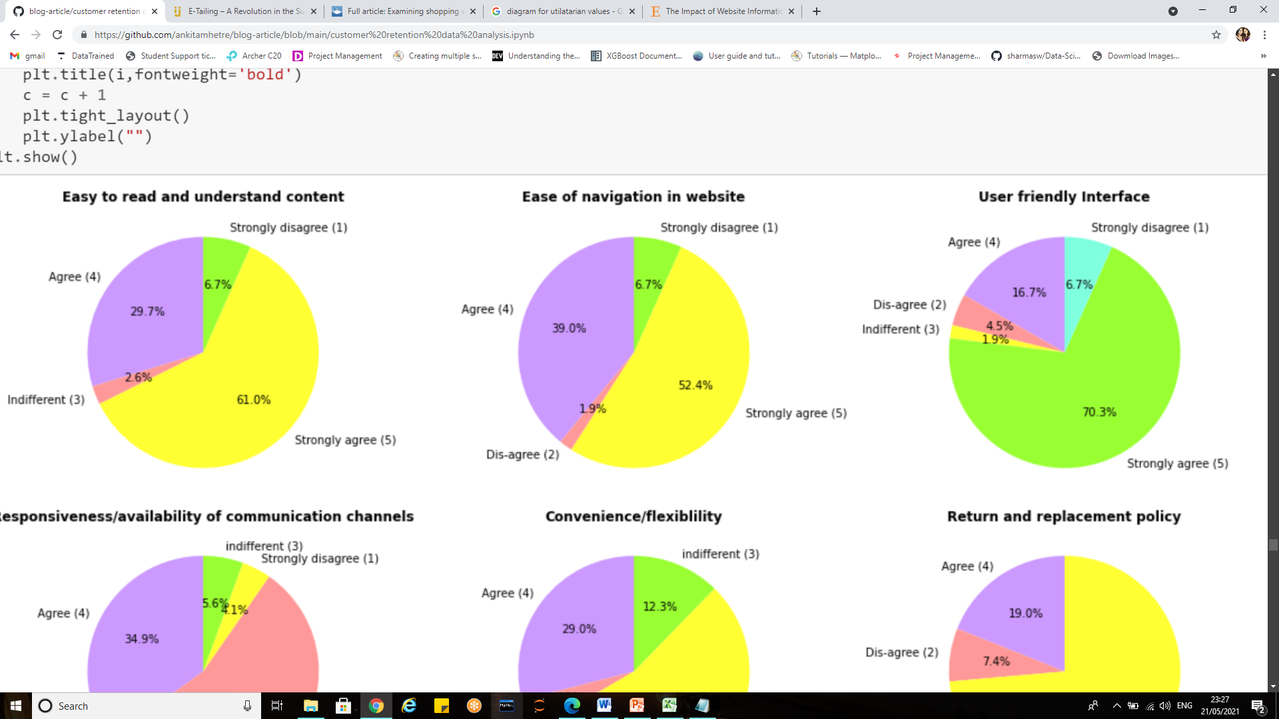
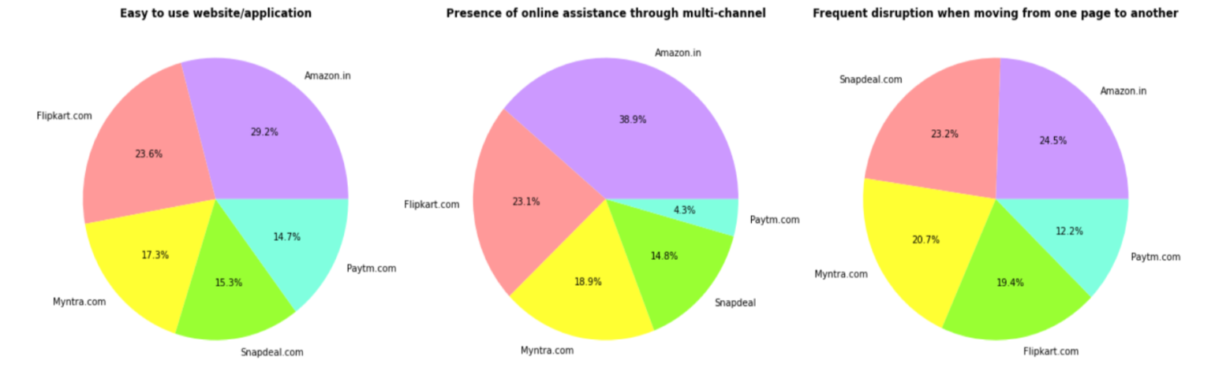
Utilitarian values visualizations contd.
Convenience:
Convenience

Slide 26
Observations
Frome the plot it is visible that the majority share belongs to "agree" and "strongly agree”. This states that people strongly believe in e-retail websites to be convenient.
Various factors that led to convenience were Easy to read and understand content, Ease of navigation in website’, User friendly Interface, Responsiveness/availability of communication channels, Convenience/flexibility, Return and replacement policy and Convenience of patronizing.
The content should be easily understood and read in order to avoid confusion
User-friendly interface ensures that the person accessing website feels it easy to understand and use the application/interface
Ease in navigating the web pages and flexibility increases the overall user- interface.
Web site information convenience is an important factor to attract customers and make a connection between them and company’s product or services
Thus amazon and flip kart were considered more convenient in terms of ease of use, presence of online assistance.
There were frequent disruptions while moving from one page to another in amazon and myntra.
Amazon provided great online assistance from various channels.
Paytm has shown smooth transaction while moving between pages.

Slide 27
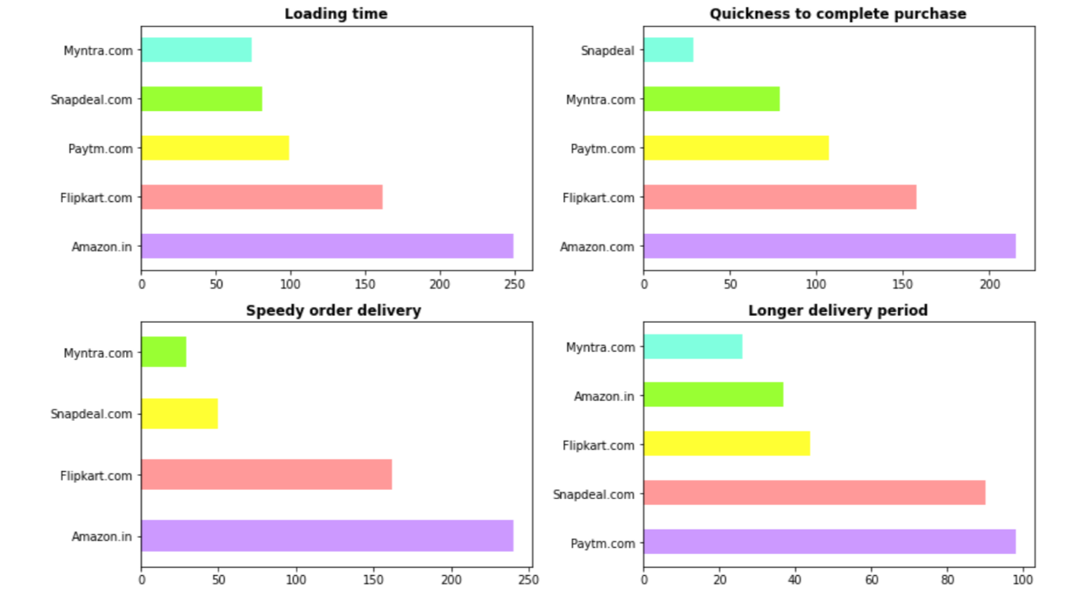
Utilitarian values visualizations contd.

Slide 28
Observations
Observation for loading time:
Therefore we can conclude that the Fast loading website/application was amazon.in followed by flipkart
Myntra has the lowest votes in terms of loading speed
Observation for quickness to complete purchase order:
From the plot it is clearly visible that the amazon websites showed quickness to complete the purchase order the most.
snapdeal was the one which got least votes for quickness to complete the purchase order
Observation for speed of delivery:
people preferred amazon as the one providing speedy delivery
Flipkart too had many records in terms of speedy delivery
Myntra can be seen as the slowest one
Observation for Longer delivery period:
The fastest delivery was made by Myntra followed by amazon and flipkart
Paytm and snapdeal took longer time in delivering the purchase orders to customers.

Slide 29
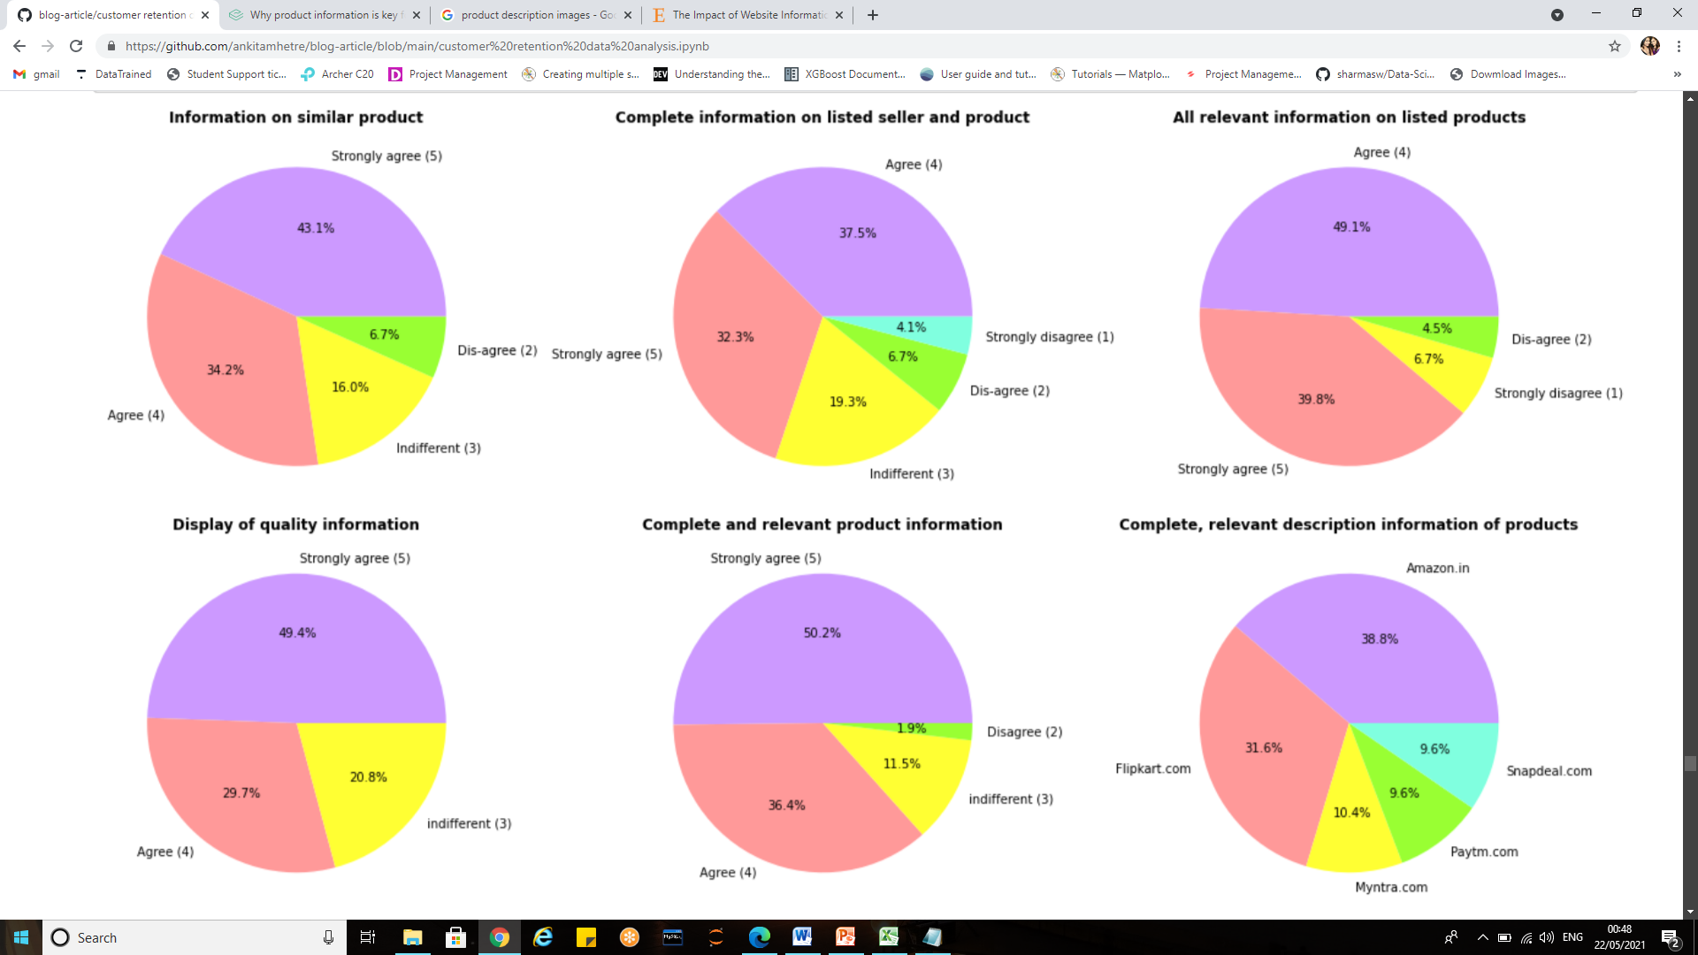
Product information
Utilitarian values visualizations contd.

Slide 30
Observations:
From the first four pie charts it is very clear that the highest percentage is dedicated to "Strongly agree" and "agree", which states that people usually look for e-retail websites which can successfully provide complete and relevant information on all the products.
The information should be clearly stated so that customers can compare each product's information and make purchase decision.
Thus displaying quality information will ultimately lead to customer satisfaction
Among the entire mentioned e-retail website "Amazon" and "Flip kart" provided good piece of information on their products. Myntra Snap deal and paytm did not provide much relevant information on the products.

Slide 31
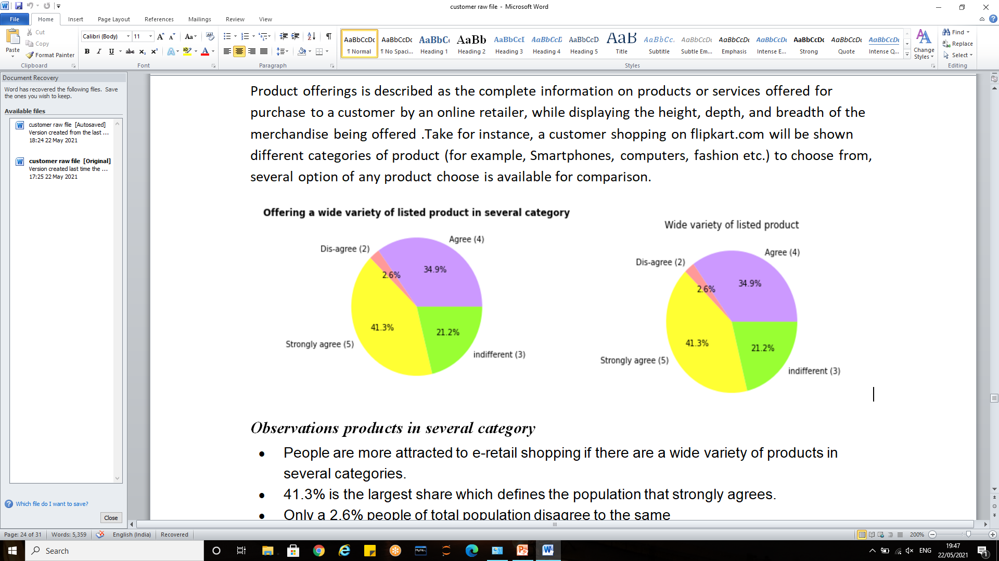
Utilitarian values visualizations contd.
4)Product offerings:
Observations products in several category
People are more attracted to e-retail shopping if there are a wide variety of products in several categories.
41.3% is the largest share which defines the population that strongly agrees.
Only a 2.6% people of total population disagree to the same
Observation for wide variety of listed product
People tend to buy more from e-retail websites if there is a wide variety on the products that are listed.
Few people (21.2%) had indifferent views.
A very small portion i.e.2.6 % dis-agreed that the variety will lead to customer retention.

Slide 32
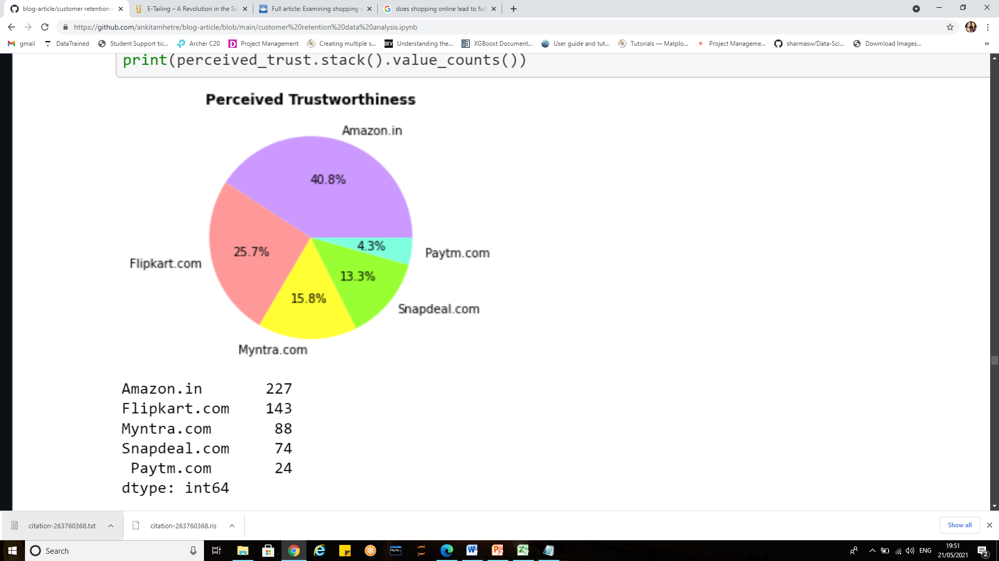
Perceived risks/trustworthiness
Observations for perceived trust:
From the available e-retail websites Amazon and Flip kart are considered more trustworthy.
Paytm was not much successful in building customer trust
The more trustworthy an online vendor is perceived by a customer, the more likely this customer is to take an actual financial risk towards this vendor.

Slide 33
Conclusion
This project provides various insights on how one can study the customer behavior and use it to build and grow e-retail business
The project sheds light upon creating solid customer retention strategies, with the help of predictive analytics to make predictions about the future, by looking at historical data, to learn what customers may like or dislike.
We can rely on power of machine learning to quickly and accurately uncover the underlying reasons of why customers are churning or why they’re loyal to your brand.
From the data analysis we observed how the hedonic and utilitarian values are responsible for any e-commerce website to retain the customers.
It is always better to retain the existing customer as the cost of acquiring new customers is too high.
The hedonic and utilitarian values both should go hand-in-hand ,thus in order to build a successful business model it becomes important to study the customers requirement and work to satisfy them .

Slide 34
Conclusion contd.
A combined approach designed to increase customer satisfaction, trust, and the overall net benefits of shopping on their e-store must be adopted to achieve goals
Online retailers must focus on the information quality and system quality of the online retail websites to enhance customer satisfaction, which in turn will lead to repurchase decision.
Both the utilitarian and hedonistic values led to customer satisfaction and considerably stimulate their repurchase intention, leading to loyalty.
The result further suggests that customers’ perception of utilitarian and hedonic values will inform their preference for a particular online store. Hence, attention to the customer specific content is very much vital.
It is hoped that the e-commerce platform and retailers will work together to pay attention to consumers’ preferences and perceived value, continuously improve management and service quality, and continuously improve consumer well-being and achieve a win-win situation for corporate profitability and consumer satisfaction.

Slide 35
Thank you

